Slide 1
Photomicrographs of Plant Seeds
Micrometer units: 10X, 16X, 25X
For use in measuring photographs of seeds
Dr. David O. Norris at
david.norris@colorado.edu

Slide 2
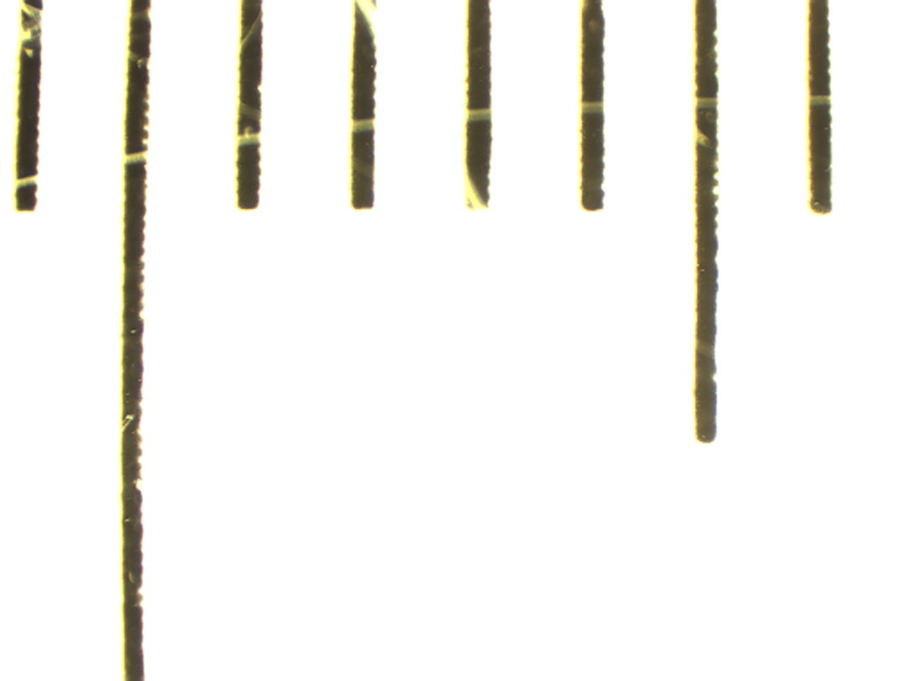
0.1 mm
10X
Notes:
Scale for seed at 10X. 1 unit = 0.1 mm (arrow = 100µm).

Slide 3
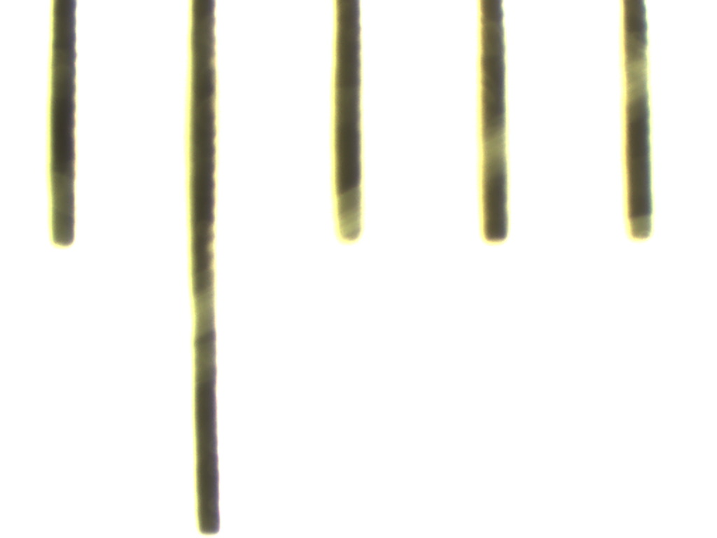
0.1 mm
16X
Notes:
Scale for seed at 16X. 1 unit = 0.1 mm (arrow = 100µm).

Slide 4
0.1 mm
25X
Notes:
Scale for seed at 25X. 1 unit = 0.1 mm (arrow = 100µm).

